Slide 1
Child Section, NWI
7-12 years of age
Marit Coldevin

Slide 2
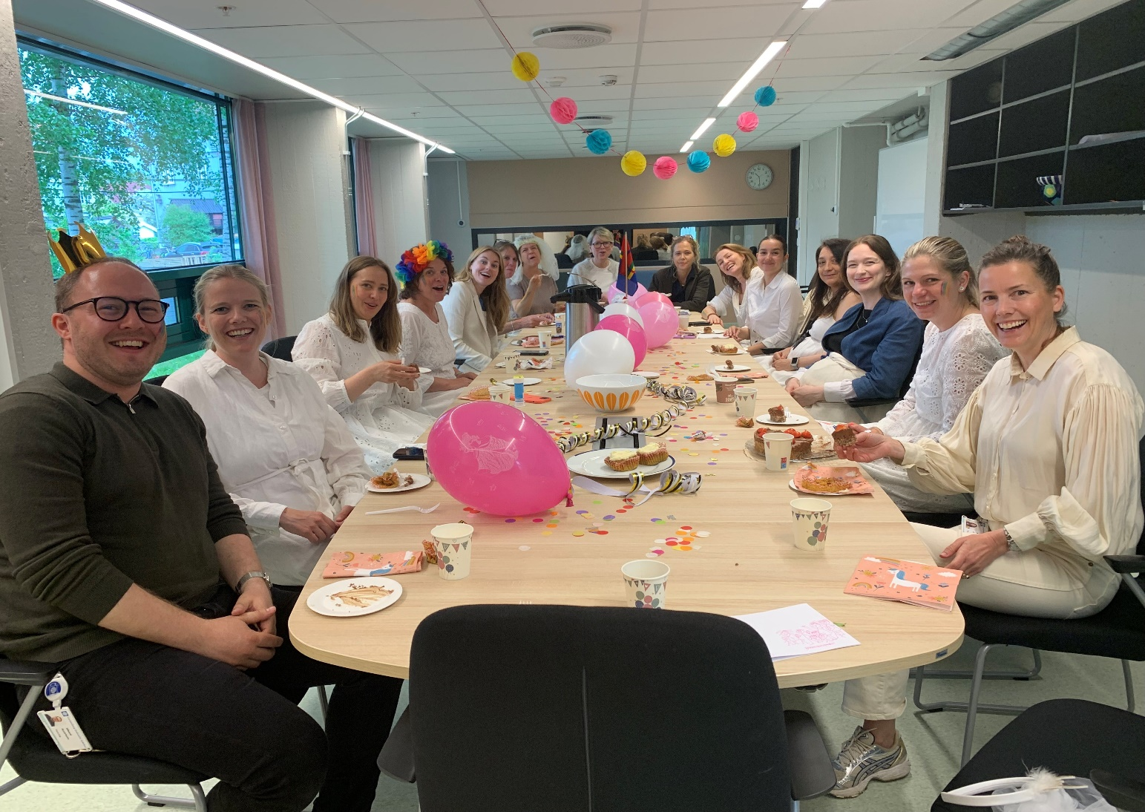
The Child Section consists of 18 clinical psychologists, psychiatrists, doctors in training, pedagogists, nutritionist and social workers.

Slide 3
Overview of the most common disorders in the child patient group (with a rising number of ASD..)

Slide 4
Assessment and diagnostic evaluation
Anamnestic
interview
Child focused consultation
Diagnostic interview
School Observation
Psychiatric/somatic evaluation
WISC- general cognitive ability

Slide 5
Emotion focused parent therapy
Dialectical behavioral therapy for children
DBT-C
Tuning into kids- Group based parental training
Autismspectrum
Group based parental psychoeducative training
Sensory Motor Arousal Regulation Treatment (SMART)
Play based therapy with children
Medication
Mostly stimulants
Exposure training
Anxiety/OCD
Mentalization-based child therapy
Treatment

Slide 6
Emotional dysregulation is a transdiagnostic symptom and highly present in the clinic
We work with and through caregivers and teachers
We have high focus on system-based treatment
Pilot project with DBT-C – a therapy for children with severe dysregulation, self-harm and often comorbid diagnoses:
Emotional regulation training for parents in groups
Mindfullness
Exposure to negative emotions
Skills training

