Slide 1
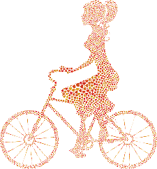
Crisis Intervention and Home Treatment Unit
June 2023
Per Martin Løken, head of section
Crisis Intervention and Home Treatment Unit
Notes:
Head of the Crisis Intervention and Home Treatment Unit
Opened the unit in June 2022 as an expansion of the emergency child and adolescent psychiatry in Oslo

Slide 2
Inpatient clinics
Area function
Two routes to inpatient clinics – elective and accute
Front units OUS
Intensive outreach treatment
Crisis Intervention and Home Treatment Unit NWI
Intensive outreach treatment
BUP Oslo Nord
Outpatient clinic
BUP Oslo Syd
Outpatient clinic
Nic Waals Institutt
Outpatient clinic
BUP Vest
Outpatient clinic
Local hospital
Community services
Oslo county districts
Oslo county districts
Oslo county districts
Oslo county districts
Per Martin Løken, head of section
Crisis Intervention and Home Treatment Unit
2
Notes:
In Oslo there are four hospitals running outpatient clinics, and two hospitals running inpatient units.
The Crisis Intervention and Home Treatment Unit lies between outpatient and inpatient levels, with an outreach profile
The Crisis Intervention and Home Treatment Unit covers two of the outpatient clinics in Oslo, covering two of the four hospital sectors in Oslo

Slide 3
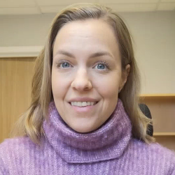
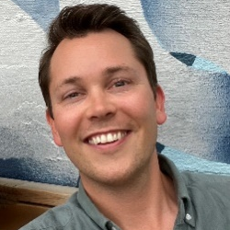
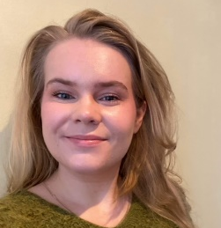
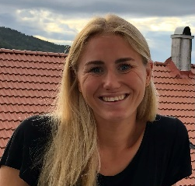
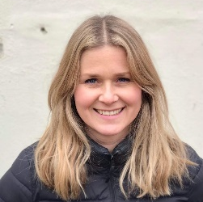
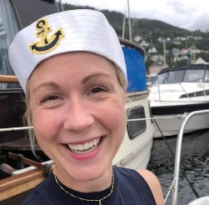
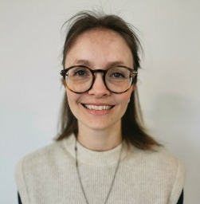
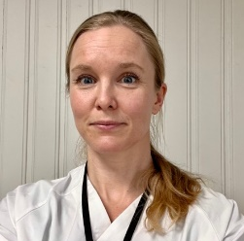
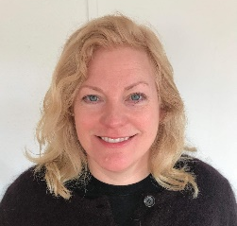
Crisis Intervention and Home Treatment Unit
Cathrine Martinsen
Secretary
Per Martin Løken
Frida Bordevich Ballo
Heidi Eriksen Eldholm
Thorstein Holt
Live Husum
Head of section
Clinical psychologist
Clinical psychologist
Social educator
Educational specialist
Clinical psychologist (specialist)
Child welfare worker
Synne Solnørdal Jenssen
Hilde Lysne Mathisen
Kaja Aasbø Stavelin
Marie Dahlberg Tonga
Therese Wang
Clinical psychologist
Clinical psychologist
MD
MD
Social educator
(specialist)
(specialist)
Psychiatric nurse
Per Martin Løken, head of section
Crisis Intervention and Home Treatment Unit
Notes:
Our unit consists of in total 11 workers, including 5 clinical psychologists, two medical doctors, two social educators, one educational specialist and one secretary

Slide 4
CRISIS
Psychosis
Suicidal problems
Self injury
Eating disorders
Aggression and violence
0-6 years
MOBILE
Outpatient treatment is not enough
Unable to attend outpatient treatment
C
I
H
T
Per Martin Løken, head of section
Crisis Intervention and Home Treatment Unit
Notes:
To qualify for referral to the Crisis Intervention and Home Treatment Unit , there must be psychiatric emergency elements, such as psychosis, suicidality, eating disorders of severe aggression, in addition to a need for mobile treatment, due to diffuculties with coming to ordinary outpatient treatment, or due to a lack of treatment effect in ordinary outpatient treatment.
Our goal is to prevent the need for hospitalization for the kids and adolescents in our sectors, by offering intensive and specialized psychiatric treatment at home, and thus contribute to them being able to continue with ordinary outpatient treatment.

Slide 5
Course of treatment
Admission
Meeting with outpatient therapist
Written referral
Treatment (8 weeks)
Individual therapy
Parental counselling
Family therapy
Network support
Environmental therapy/interventions
Medication
Monitoring
Assessments/diagnostics
Post treatment
Discharge summary
Per Martin Løken, head of section
Crisis Intervention and Home Treatment Unit
Notes:
Before treatment in our unit we require a written referral from, and a pre treatment meeting with, the outpatient therapist.
We offer a wide array of treatment methods, such as individual therapy, parental counselling, family therapy, environmental therapy, medication and diagnostic assessments

Slide 6
Competence
Basic
Experienced clinicians
Clinical specialization
Specialized training
Psychosis
Psychoeducational family program (PEF)
Eating disorders
Family based therapy (FBT)
Suicidality, nonsuicidal self injury and aggression
Dialectical behavior therapy (DBT/DBT-C)
Per Martin Løken, head of section
Crisis Intervention and Home Treatment Unit
Notes:
All of the therapists in the unit are experienced clinicians, and they either have acquired or are persuing a specialization degree according to their professions.
We have also acquired specialized training in treatment of psychosis, eating disorders, suicidality and severe aggression in accordance with national and international guidelines.

Slide 7
Status
Population
15 active cases
More than 65 families the last year
5-18 years
Gender balance
Referral causes
Suicide attempts and impulses
Psychosis/psychotic symptoms
Eating disorders
Severe aggression/violence
Severe anxiety/OCD
Emotional instability/personality disorders
Self injury
Depression
Substance abuse
Harmful sexual behavior
Mania/hypomania
ASD
Per Martin Løken, head of section
Crisis Intervention and Home Treatment Unit
Notes:
The Crisis Intervention and Home Treatment Unit has been operational for about one years, and so far we have treated about 65 families with children ranging from 5 to 18 years.
We experience that most of our patiens have complex problems with the need for intensive and multifactory treatment in order to get better and be able to continue with ordinary outpatient treatment.

