Slide 1
Ambulatory treatment service
Nic Waals Institute
Study tour, French National Association of Psychiatrists
21.06.23
Assisten head of department Sjur Dugstad

Slide 2
What is amulatory treatmen?
Refers to providing mental health services in an outpatient setting
Part of the desentralisation of health care:
  Reaching out with treatment closer to where people live their lives.
  Enhance accessibility

Slide 3

I like to climb mountains
* Experience with patients that are hard to reach and need indivualised treatment:
  - Inpatien treatment for serious mental illness
  - Compulsiv treatment
  - Hospital clinic serving inmates within prisons
* Clinician at this unit for 2,5 years
* Recently also assisten head of ambulatory department

Slide 4
Ambulatory treatment service is growing:
Head of ambulant department :
Ambulatory unit
35 patients
FACT youth
district of Grünerløkka
20 pasienter
FACT youth
district of Gamle Oslo
30 pasienter
FACT youth
district of St. Hanshaugen
20 pasienter
2019
40 patients
6 employee
1 unit
2022
105 pasienter
11 (26) employee
4 units
4 locations

Slide 5
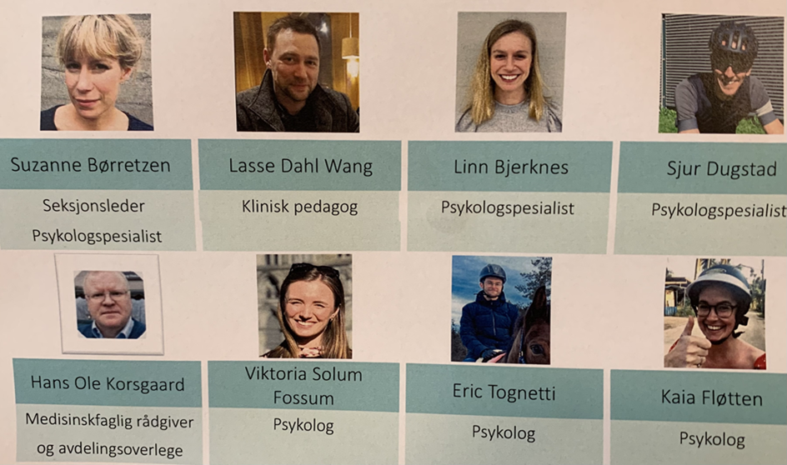
Staff
Ambulatory treatment unit
3 x specialists in clinical psychology
Clinical psychologists
Specialist in psychiatry
1 x clinical Pedagogue
Total of 6 staff

Slide 6
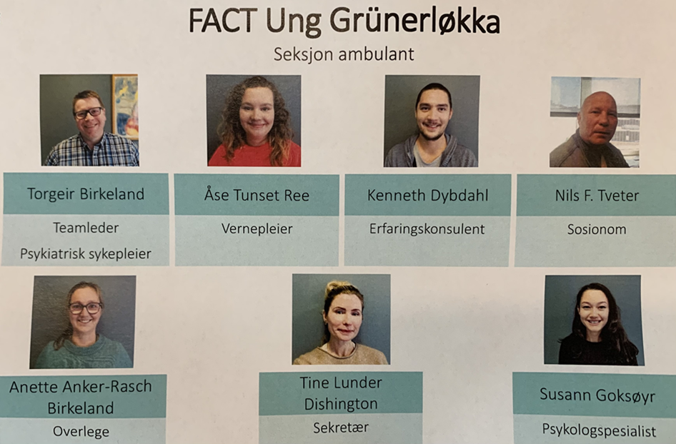
Staff
FACT Youth
Specialists in clinical psychology
Clinical psychologists
Specialists in psychiatry
Social workers
Child welfare workers
Family therapists
Peer support workers
Total of appr. 17-20 staff

Slide 7
AMBIT
Adaptiv mentalization based integrativ treatmen

Slide 8
Who are the the patients at ambulant section
- the intern unit?
Age: 10 – 18 years old .
«Do not show up to consultations or has not benefitted from ordinary treatment.
Severe mental disorders and complex mental conditions where basic function has collapsed
The diagnostic understanding is unclear og the condition is unstable and there is suspition of serious mental disorder
There is need for intensiv treatment, targeting not only the individual patient, but also their family and the system around the patient.

Slide 9
Conditions we often meet
Attempted suicide or elevated risk of suicid
Eating disorder
Psychois og psychotic symptoms
Conduct disorder
Violent risk
Grunnleggende funksjonssvikt
Invasiv compultions og anxiety
Autism spectrum disorders with comorbid mental disorders
ADHD
Borderline personality disorder
Drugs
Self harm
Depresion
Families in crisis or coflicts

Slide 10
Status
Patient caracteristics:
19 boys, 15 girls
9/34 patiens has been admitted to the acute ward for youth
2 pasients are at the acute ward
3 patients are waiting for inpatient treatment.
:

