Slide 1
Infant and Preschool Department (0-6 years) Pregnant Women and their Partners Nic Waals Institute

Slide 2
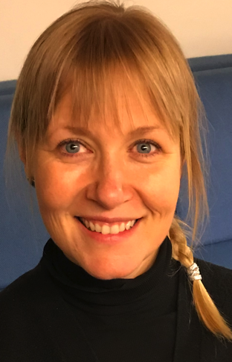
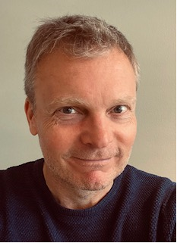
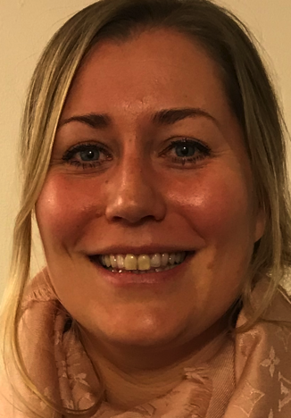
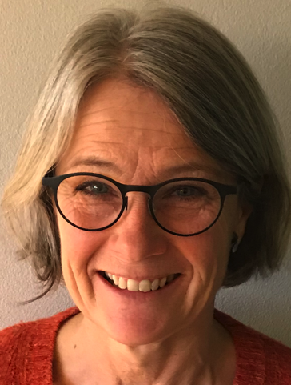
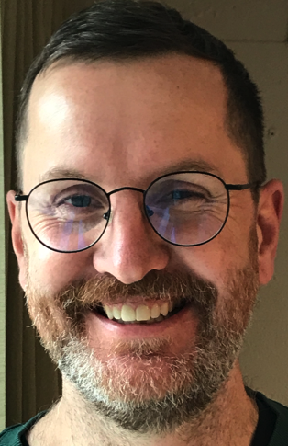
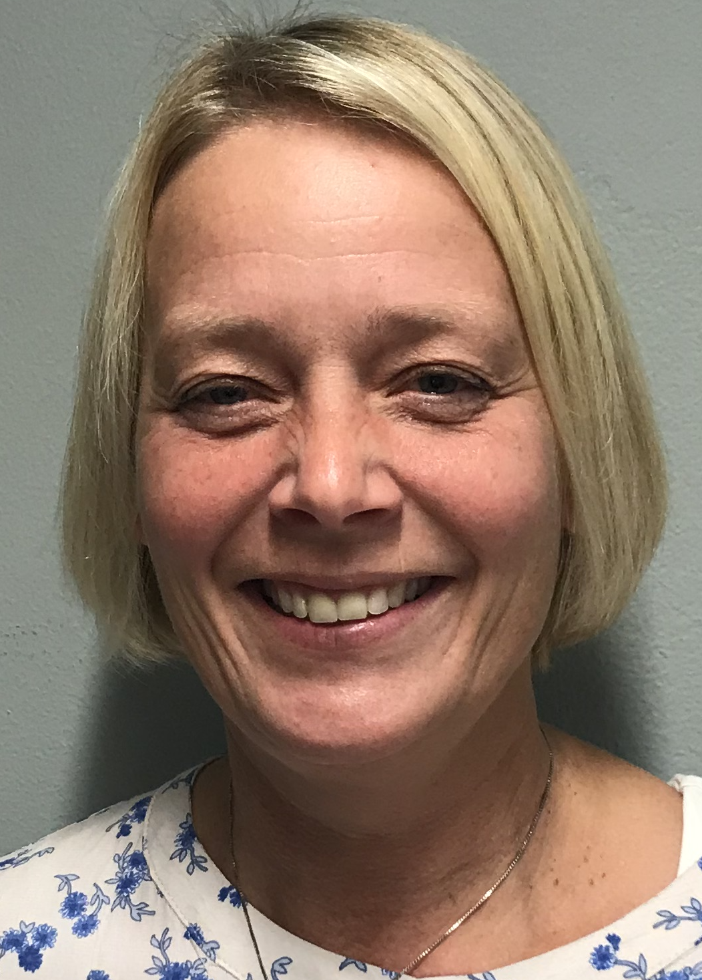
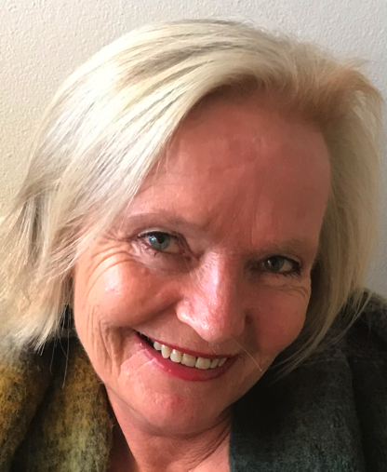
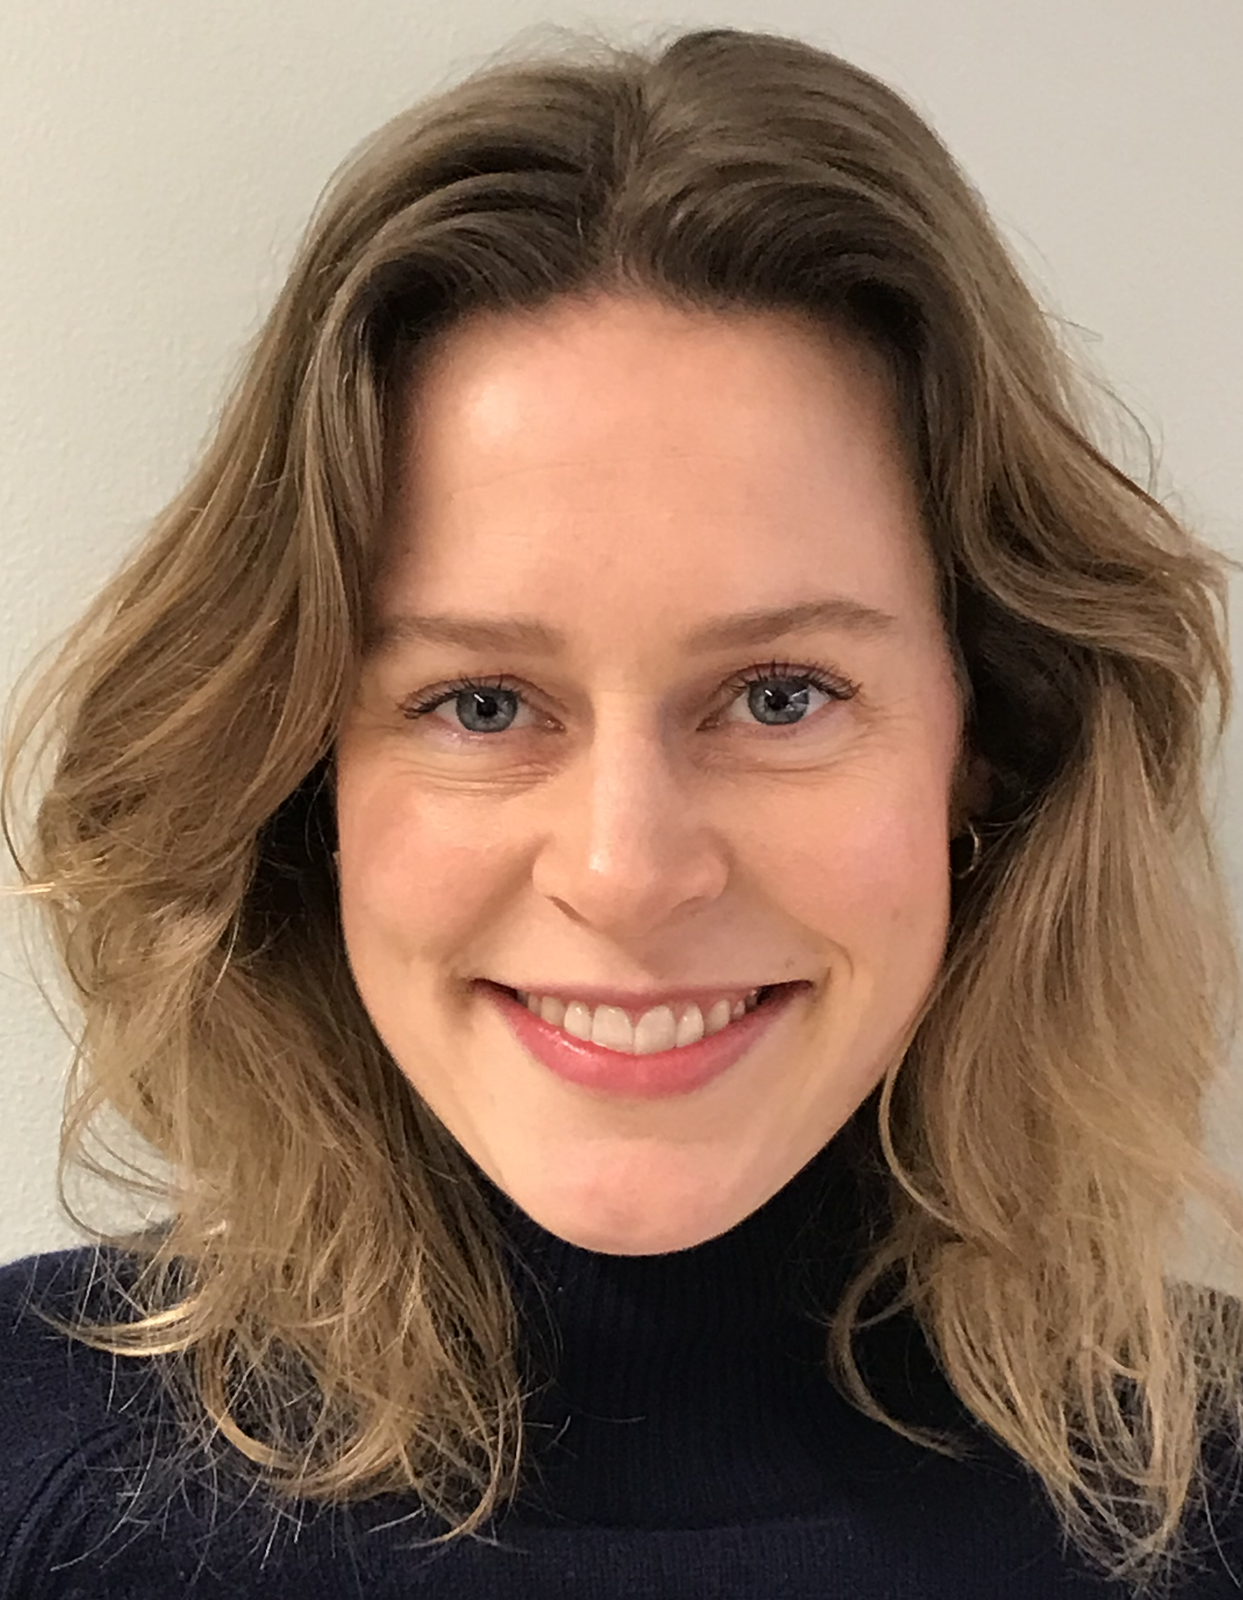
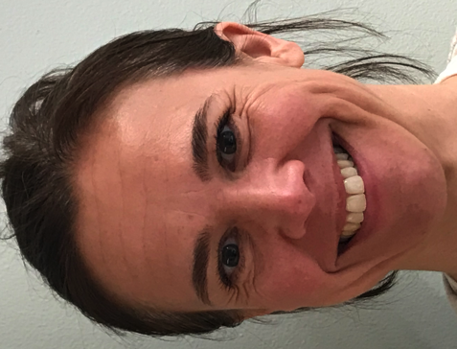
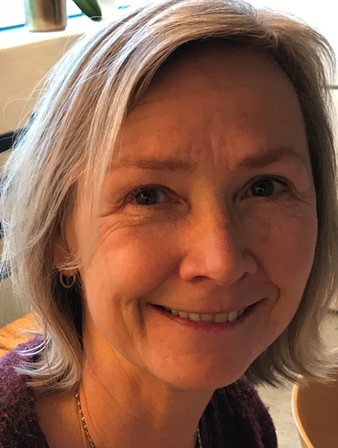
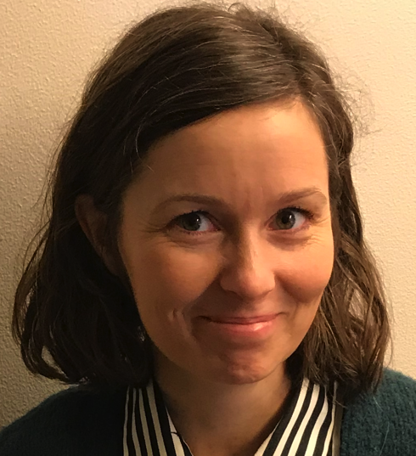
Britt Møller
Secretary
Anne-Siri Øyen
Leader, PhD
Specialist Clinical Child & Adolescent Psychology
Anna Engell Gilbert
Psychiatrist and Family Therapist
Anne Haukvik
Specialist Clinical Child & Adolescent Psychology
Arve Bjelland Grov
Specialist Clinical Psychology - Family Therapy
Bente Ulleberg
Specialist in Health Nursing Infant/Preschool/Pregnancy
Fredrik Cappelen
Specialist Clinical Child & Adolescent Psychology
Psychoanalyst
Hedvig Kleivi
Specialist Clinical Social Work
Ingun Isene
Specialist Family Therapy
Julie Wasmuth
Clinical Psychologist
Karoline Tysnes
Specialist Clinical Child & Adolescent Psychology
Marianne Strandskogen
Clinical Social Work
Maud Heie Bjerke
Specialist Clinical Child & Adolescent Psychology Specialist Clinical Adult Psychology

Slide 3
Our team consists of various specialists from different professions
1 psychiatrist with adult specialty and family therapy
7 clinical psychologists
2 clinical social workers
1 music therapist/family therapist
1 health nurse with specialty in infancy/pregnancy

Slide 4
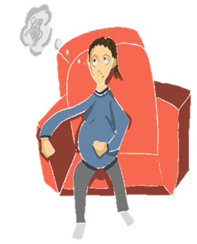
Reasons for referral to the Infant and Preschool Department
Pregnant women and their partners
Mental health issues affecting pregnancy
Post partum depression
Childhood trauma/PTSD
Attachment difficulties to fetus
Children 0-6 years
Concern about attachment/interaction
Concern about development
Childhood trauma/violence
Autism spectrum difficulties
Neurodevelopmental concerns
Language and social delays
Anxiety
Selective mutism
Anger/tantrums
Encopresis/Enuresis

Slide 5
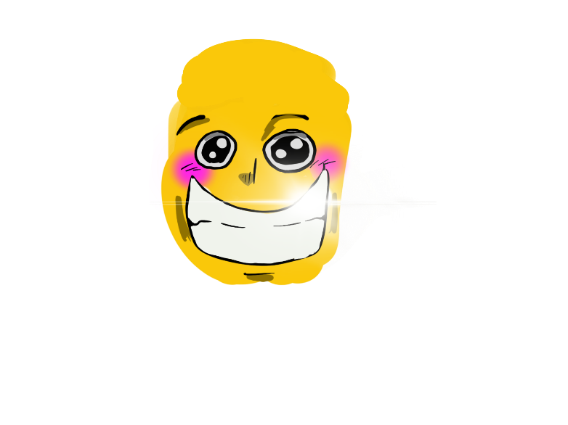
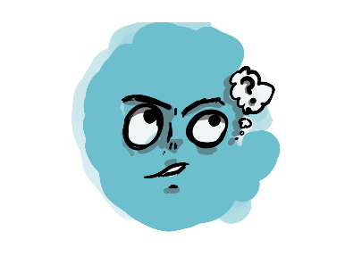
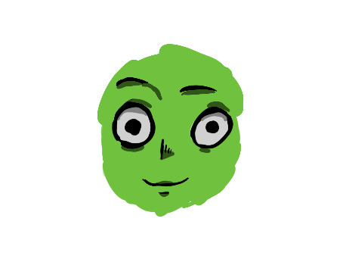
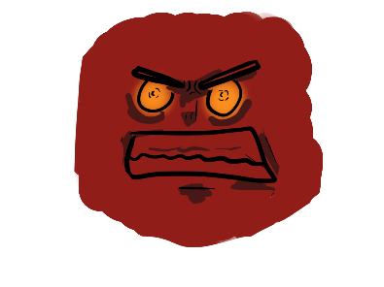
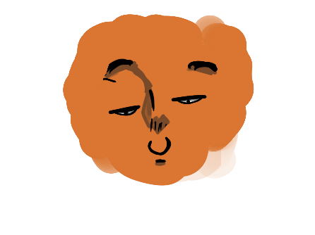
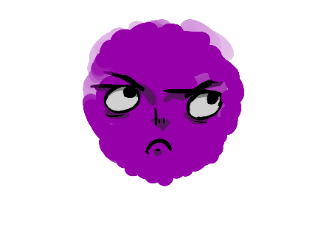
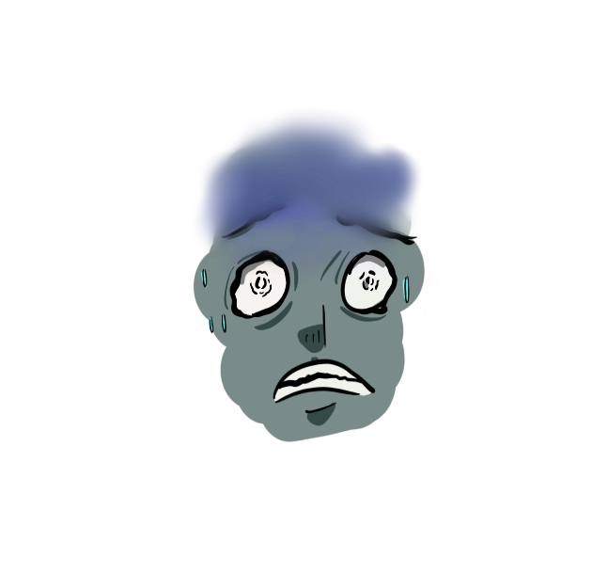
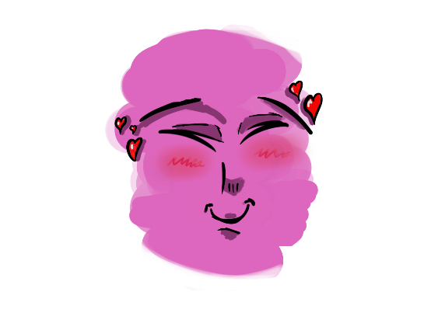
Information to the child
Hei!
Første gangen du kommer til oss, er det sammen med foreldrene dine.
Vi leker, prater, tegner og blir kjent.
Du får dette brevet fordi en voksen har bedt om at dere skal få komme til oss. Vi heter Nic Waals Institutt, noen sier også BUP.
Her prater barn så mye eller så lite de vil. Noen liker
å bare høre på hva de voksne snakker om.
Her jobber det mange voksne som hjelper familier og barn som har det vanskelig.
Noen barn som kommer hit er mye triste og lei seg.
Vi har også møter med de voksne alene, og så bestemmer vi hva vi skal gjøre for å hjelpe barnet og familien til å få det bedre. Noen barn er her noen få ganger, mens andre kommer hit mange ganger.
Andre barn er ofte sinte.
Andre liker ikke å
bæsje på do.
Noen har det vanskelig i barnehagen eller på skolen.
Noen barn har opplevd skremmende og skumle
ting.
Vi gleder oss til å treffe deg, og til å bli kjent med deg!
Andre barn har en stemme som ikke alltid virker.

Slide 6
Types of assessments and interventions
Pregnant women and their partners
Intake interview
Pregnancy history
Attachment based interviews (Working Model of the Child Interview)
Couples therapy
Individual therapy
Collaboration with Adult Psychiatry, Obstetric Units and Community Health Units
When the baby is born the child has to be referred and becomes the primary patient
Groups
Nurture and Play
Mother and Child Groups
Group for fathers
Children 0-6 years
Assessment phase
Intake interview/family session
Developmental history
Observations at the clinic,kindergarten/school
Specialized assessments:
MIM (Marschak Interaction Method); Crowell
Cognitive assessments
Autism specific assement (ADI-R/ADOS)
Child somatic assessment
Play therapy assessment
Interventions
Parent guidance and parent groups (TIK; COS)
Interaction interventions (Theraplay; Watch Wait Wonder)
Family therapy
Play therapy/Child Parent Psychotherapy (CPP)
Systemic Network Collaboration

