Slide 1
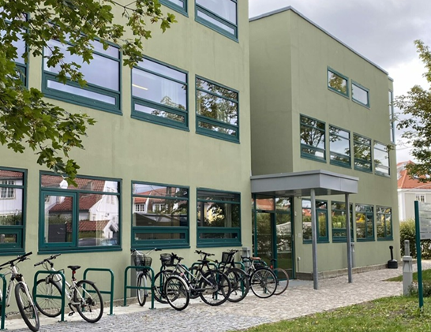

Nic Waals Institute
A brief presentation of our history and of the institute today
by
Benedicte Skirbekk, MD PhD, Head of NWI
bski@lds.no

Slide 2
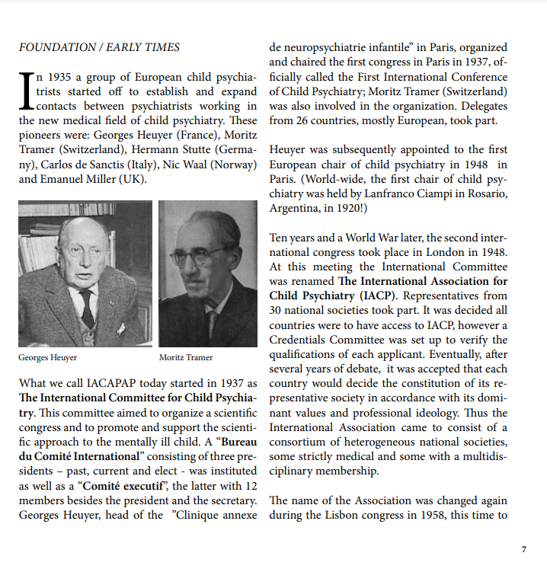
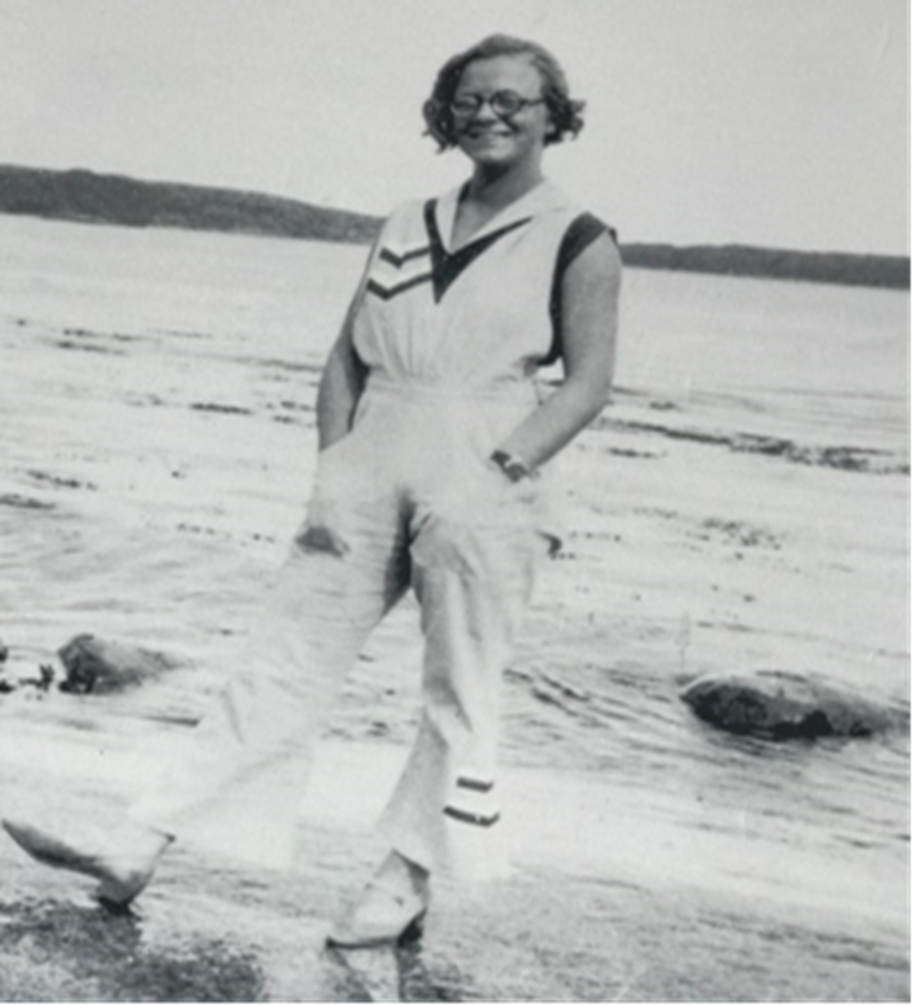
Nic Waal
1905-1960
Child and Adolescent Psychiatrist
Cofounder of the precursor of IACAPAP in 1937 together with the French pioneer in child psychiatry Georges Heuyer
Established Nic Waals Institute(NWI) in 1953
Since 2004 NWI part of Lovisenberg Diakonal Hospital
From «The history of IACAPAP» by Kari Schleimer
Nic Waals Institute moved in to our current premises in 1969

Slide 3
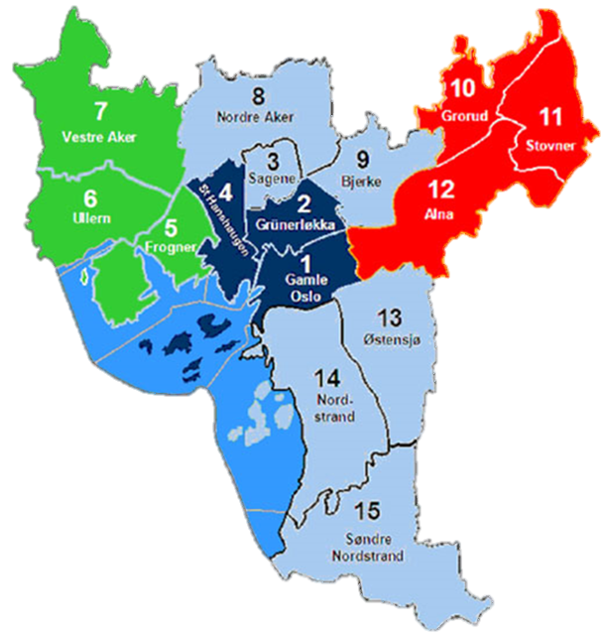
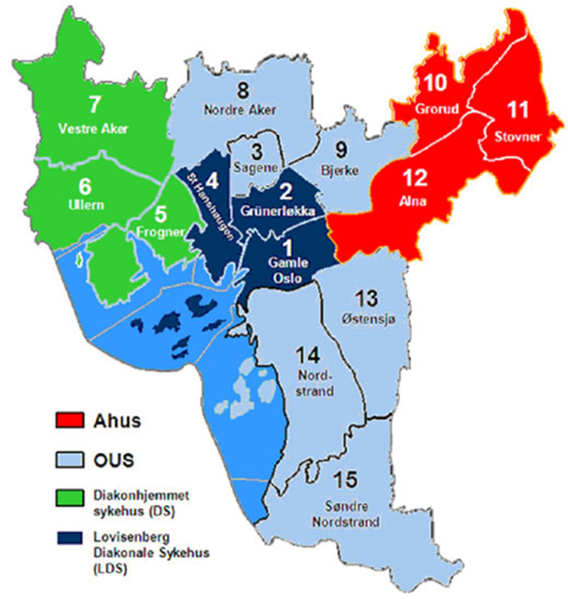
Nic Waals Institute (NWI)
Oslo is divided into 15 districts (arrondissement)
Child and Adolescent Mental Health Service (CAMHS)
NWI is the local outpatient clinic for four districts
(1,2,4 & 7)
Population <18 years old: approx. 35.000
Inner city east
(7: west)
In Oslo (simplified): divide between the east and west side in terms of wealth
1,2 and 4
Outpatient clinic

Slide 4
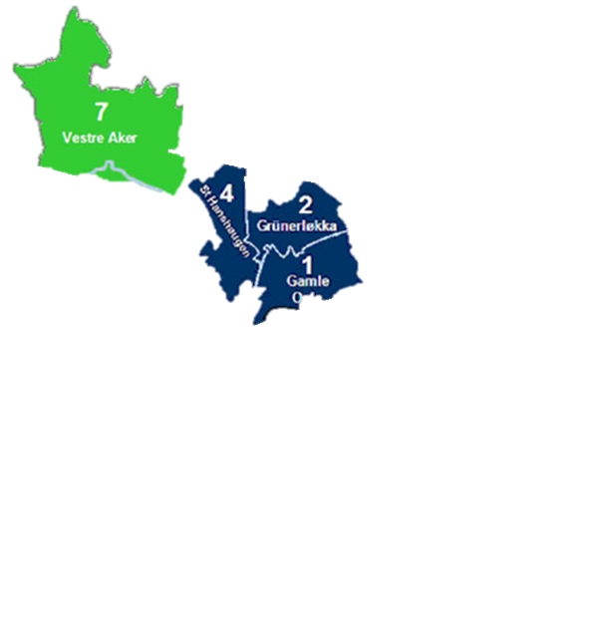
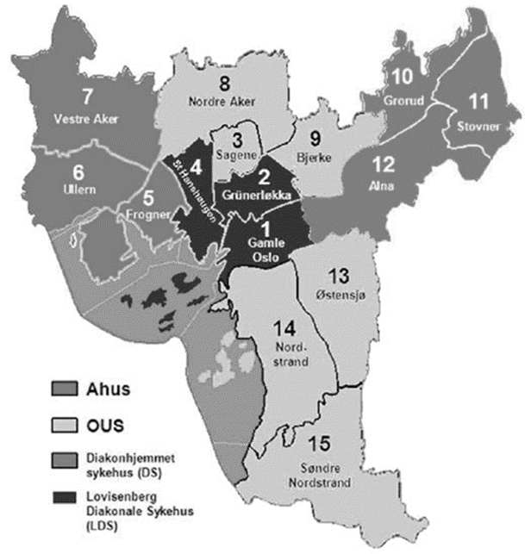
Characteristics of the inner city east population
Compared to the Oslo average:
Population growth: 80 % higher
Low income households with children: 30 % more
Cramped quarters with children 35 % more
Single parent households: 28 % more
School drop-out 16-19 years: 49 % more
Used cannabis: 90 % more
Lung cancer (new cases): 30 % more
Life expectancy men: 3,7 y shorter
Life expectancy women: 2,2 y shorter
Source: www.fhi.no

Slide 5
INPATIENT CAPACITY IN OSLO IS LIMITED
Oslo University Hospital (OUS):
Inpatient CAMHS for 12 of Oslo’s 15 districts, including the Lovisenberg area
(Population <18 yrs: 107.000)
  5 beds in acute inpatient ward for adolescents
  (13-17yrs)
  6 beds in elective inpatient ward for adolescents
  (13-17yrs)
  6 beds in elective inpatient ward for children
  (4-14yrs)
Outpatient clinics therefore need to provide treatment to patients with severe conditions

Slide 6
NWIs treatment services
In-house departments
Home treatment departments/teams
Infant/preschool department (0-6 yrs, and pregnant women)
Child (7-12 yrs) department
Adolescent department (13-18+ yrs)
Ambulant department
  Home/arena flexible treatment unit
  FACT young teams
Crisis Intervention and Home Treatment Unit

