Slide 1
Study tour of the French National Association of Psychiatrists, Presidents and Vice presidents of medical comittees of Hospitals
Gitte Huus, Sjur Øvrebø, Jonas Uchermann, Bernt Bull
Oslo 19.06.23

Slide 2
Program
14:00: Welcome, presentation
14:15: A very short brief on the norwegian health system
14:30 – 15:30: Policy, status and dialog on mental health and addiction treatment
Some highlights from the Mental Health Escalation plan
Drug free treatment and forced treatment
Substance abuse treatment

Slide 3
The Norwegian Healthcare System

Slide 4
Norway
Monarchy
Constitution from 1814
Independence since 1905
Labour/Centre coalition government since 2021

Slide 5
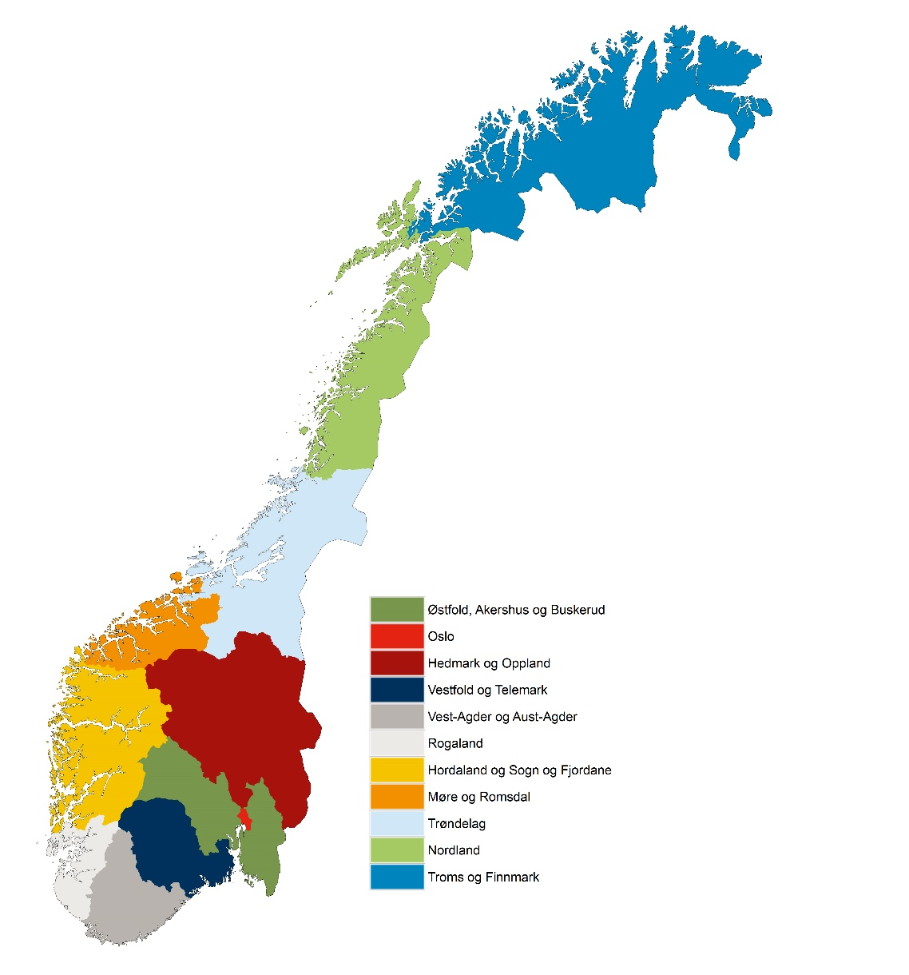
Basic facts on Norway
Population: 5,3 million
Political organization
3 administrative levels: State/national, regional (region) and local (municipality)
Ongoing regional reform
- From 19 to 11 counties - From 426 to 381 municipalities
Life expectancy at birth:
Females - 84
Males - 80
Health expenditure : app 10 percent of GDP (2021)

Slide 6
An overview
Patient´s Rights of great importance
Equal access for all to health care services
Universal health coverage by state – but increasing number have private insurance policies
Participation in decision making
Financing
Mostly publicly provided and financed (~85%) - tax based
Responsible authority for providing services
The responsibility of providing health care is divided between the municipalities (primary health care and care for elderly) and the state/regional health authorities (hospitals)
Health service - mostly a public service
Very low share of private services and hospitals
Most private actors operate within the public system and refunded by state

Slide 7
The Municipalities
Responsible for providing most primary services
Must provide:
Promotion of health and prevention of illness and injuries
Diagnostics, treatment and rehabilitation
Nursing care within and outside institutions, including long term care
The general practitioners scheme
Emergency first aid medical services

Slide 8
Cornerstone in health system – GPs
Each citizen has a dedicated GP
On average 1050 people on a GP´s list
85 % of GPs are self-employed
Key role in coordinating medical services and referring to specialist health services when needed
Financing:
from the municipality
reimbursement from the National Insurance Scheme
patient’s charge

Slide 9
The Hospital Sector
North
The state is responsible for all specialized health care
Four Regional Health Authorities, owned by the state
20 Health Trusts, 19 offers mental health treatment
60 hospitals
Six university hospitals
80 clinics for mental health treatment for children
Around 75 clinics for grown ups
Hospitals
Mid
West
South-East

Slide 10
Hospital Sector Governance
Parliament decides annual budget.
Annual letter of instruction from the Ministry to the Regional Health Authorities.
Regional Health Authorities provide funding and sets targets through letters of instructions to their hospital trusts.

Slide 11
Challenges
Aging population
Growing diversity – multicultural society
Lack of personell
Insufficient coordination of services
Gap between resources and demands
Cost drivers: technology and medicines

Slide 12
Goals and tools to meet the challenges
GOALS
Sustainability
Equal Access
Quality and Patient Security
Cooperation
Competence
Innovation
Implementation
TOOLS
H
O W
Notes:
Aging population
Lack of personell
Important goals
Sustainability (bærekraft)
Equal Access (likeverdig tilgang til helsetjenester)
Quality and Patient Security (kvalitet og pasientsikkerhet)

Slide 13
Mental health

Slide 14
Escalation Plan for Mental Health (2023–2033)
Notes:
The government has just finalized an escalation plan for mental health. It will last for the next 10 years.
Part of the reason why we need a new plan is the increase in the number of people who need help and the decrease in access to personnel in the coming years

Slide 15
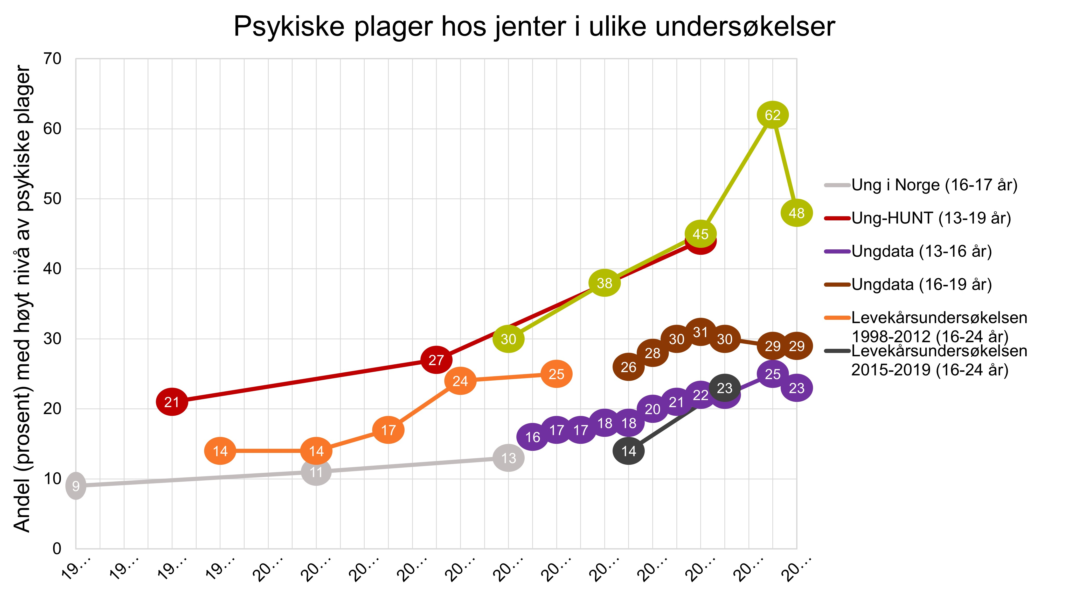
Girls’ mental health issues as seen in various surveys
Notes:
Societal changes

Slide 16
More children and young people referred to mental health services

Slide 17
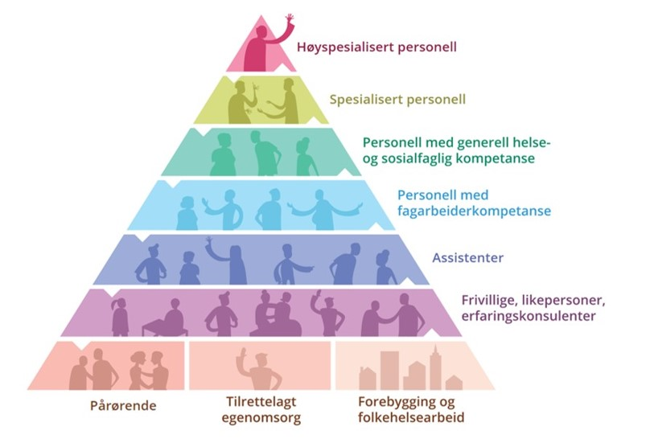
Notes:
Going forward, there will be fewer professionals per patient.
We must use the available resources in a good way.
The Norwegian Health Personnel Commission has stated in NOU 2023: 4 Time for action (REF ), that the correct division of tasks starts with
public health work,
prevention,
early intervention,
health promotion work and
strengthening the population's health skills.
In this way, patients and users can be enabled to take care of their own health and participate in their own treatment. This will also help to reduce the need for health and care services, and thus reduce the need for effort from healthcare personnel. We must strengthen the population's health skills

Slide 18
One of several important initiatives in health
Public Health Paper
Escalation Plan for Mental Health
Safe-at-Home Reform
National Health and Collaboration Plan
Preventative and Treatment Reforms Related to Substance Abuse

Slide 19
Three focus areas
The promotion of good mental health and preventative mental health work
Good services that are easily accessible where people live
Services for people with severe and complex needs

Slide 20
The promotion of good mental health and preventative mental health work
Goal to reduce self-reported mental health issues in children and young people by 25 per cent
Ascertain more knowledge about the underlying causes of the increase

Slide 21
The promotion of good mental health and preventative mental health work
Goal to reduce proportion of young people who become disabled due to mental health issues
Initiatives in the health, employment and education sectors and in partnerships between those sectors
Young people’s guarantee

Slide 22
Good services where people live
Goal to ensure that residents of all municipalities have access to knowledge-based low threshold services
Further development of digital solutions
Strengthen child health clinic and school health services
Survey low threshold services across all municipalities

Slide 23
Some facts about patients in specialized mental health services
Peak around 16-29 years old.
Around 5 percent receive specialized mental health treatment
Mostly out-patient treatment
The most seriously ill receive 24-hour treatment
Number of beds has been reduced (today around 7,6 beds per 10 000) and out-patients strengthened.
Lately: Increase in convicts for treatment and increase in forced admissions – pressure on 24-hour treatment

Slide 24
Development
24-hour places in mental health care per 10 000 inhabitans
Outpatient and outpatient man-years
Notes:
The figure on the left shows the development in the 24-hour capacity in mental health care when population development is taken into account (per 10,000 inhabitants). In the services for adults, there was a decreasing overnight bed rate throughout the period up to 2021, while in the services for children and young people, the rate of overnight beds was relatively stable throughout the period.
From 2012 to 2021, outpatient and outpatient man-years in the services for children and young people increased by almost 30 per cent when correcting for population growth (0-17 years). From 2012 to 2016, there was growth in the personnel rate (11 per cent), then the growth leveled off until 2018 (0.1 per cent). From 2018 to 2021, the staff effort in outpatient and outpatient activities increased again (16 per cent).
There was also growth in staffing in the services for adults from 2012 to 2021. Corrected for population growth (18 years and older), this resulted in an increase of over 18 per cent in the period. From 2016 to 2018, growth stopped well on its way up (1.1 per cent), but from 2018 to 2021, the rate for outpatient and ambulatory man-years increased by five per cent.

Slide 25
Good services where people live
Goal to prevent decreases in numbers of beds available and ensure that in-patient capacity in mental healthcare services remains at a level that meets demand
Goal to reduce waiting times
Notes:
At the same time, the offer in the specialist health service must be strengthened to provide better help to those who need coordinated and specialized help.
We must therefore prevent the reduction of beds and ensure that 24-hour capacity in mental health care is at a level that meets the need to look after children, young people and adults with serious mental illness who need 24-hour treatment.
The government also aims to reduce the average waiting time for mental health care both for children and young people, adults and in interdisciplinary specialized treatment of substance abuse disorders.

Slide 26
Good services where people live
Assessment interview
Pilot an integrated youth service designed for children and young people
Continue and expand the initiative relating to individual job support (IPS)

Slide 27
Take care of professionals
Goal to ensure that healthcare personnel have more time for patients, users and professional development
Reduce and streamline reporting

Slide 28
Services for people with severe and complex needs
Goal to increase life expectancy for those with mental health issues and/or struggling with addiction
Develop a comprehensive plan
Continue and further develop outreach services
Explore different models of interaction and integrated service offerings
Notes:
The third area of ​​effort is the provision for people with long-term and complex needs. A serious mental disorder can have major personal and social consequences for the individual and for their relatives.
We know that people with mental disorders and/or drug problems live shorter lives on average than the general population. Studies actually show that people with serious mental disorders or drug problems live an average of 15 years shorter than others.
In the escalation plan, we therefore set ourselves a clear goal of raising the life expectancy of those with mental disorders and/or drug problems. In order to achieve the goal, we will draw up a comprehensive plan with relevant measures.

Slide 29
Good residential services and wider service offerings at a municipal level
Continue, renew and strengthen health initiatives in the Child Welfare Service
Increase capacity for treatment and follow-up in mental healthcare in terms of both outpatient follow-ups and in-patient treatment in line with forecasts

Slide 30
Involuntary treatment

Slide 31
Danger and treatment – legal basis in different countries
Notes:
This information might be outdated (from 2004).

Slide 32
Compulsory admissions per 100,000 inhabitants (Old numbers)
Notes:
This data is from 2012, 2013, 2014 and might be outdated. Source: Internasjonalt perspektiv på psykisk helse og helsetjenester til mennesker med psykiske lidelser.pdf (helsedirektoratet.no)

Slide 33
Drug-free options in specialiced mental health care
Requested by the main patient organisations (joint action group) in the area of mental health. The Ministry welcomed the initiative
Task given from the Ministry to the regional health authorities in the assignment letter for 2015: Establish drug-free treatment options, including programmes for stepping down on medication
The service was implemented in all health regions in 2017
Two evaluations carried out, 2018 and 2020. Findings:
:
Those patients who have received treatment are in general positive
The service is reported difficult to access (lack of information, doctors are perceived as gate keepers )
Geographical variations – different ways of organising the service across the country
Some hospitals/DPS have dedicated beds, others have the treatment option integrated in the general mental health services
Drug-free treatment is highlighted in the new norwegian escalation plan for mental health

Slide 34
Legislation on decision-making competence in mental health care (2017 -> )
The history of the legislation of lack of competence in decision-making as a basis for involuntary treatment of patients with mental illness started in 2009 (The Bernt-expert group)
This report was followed by a legal review committee who submitted a report in 2011 with several suggestions on how to legislate provisions regarding lack of decision-making in mental health care (Paulsrud-utvalget)
The revision was followed up by the Ministry in 2015 with a legal proposition to the Parliament. Changes in the Mental Health Care Act were effectuated from 1st of september 2017
Why? Human rights obligations, including CRPD + An identified need in the norwegian context to strengthen mental health patients’ right to autonomy and integrity along the same principles as patients with physical health issues
Effects: Our findings indicate that the new legal provision have been positive for many patients, strengthening their voice when doctors assess their ability to consider and decide about their own health and treatment needs
Notes:
After 2017: A new legal proposal from the Østenstad-committe was submitted in 2019: Tvangsbegrensningsloven, «The act on limited use of coercion»

Slide 35
decision-making competence (continued)
Reported adverse effects: insufficient and variable deegrees of training of health personell on how to carry out sound assessments of decision-making competence. This may have resulted in
-too strict assessment practice leading to an increased rejection of patients with a need for hospitalisation /overnight stays (patients that previously could be admitted by force)
-A higher burden for parents, families or other next to kin
-The national coercion rates have risen since 2018 (after an initial drop the first year after implementation)
New Government in 2021 (coalition of the labour party and center party) decided to evaluate the legal changes
The expert group submitted its evaluation 15th of June: «Better decisions – better treatment» suggesting that the legal provision from 2017 should continue, with some modifications and supported by strong efforts from the national health authorities in training health personell and support implementing the legislation with national advisory guidelines on how to assess patients’ decision-making competence

Slide 36
Drug policies and specialised treatment

Slide 37
Drug reform 2021
Reform proposal from previous government did not pass parliament
No majority to decriminalize use and possession of drugs
Consensus to not punish drug addicted persons
Concern for children and youth
Reform criticised for little focus on prevention and treatment

Slide 38
Prevention and treatment reform
Current government aim to:
Carry out a prevention and treatment reform in order to strengthen prevention in municipalities.
Better care after treatment.
Promote a national prevention program children and youth.
Explore legal changes to insure that drug addicted persons will not face criminal charges for the use and possession of drugs, but will be referred to proper health and care services.
White paper to parliament i 2024.

Slide 39
New reform – balanced approach to substance abuse
Use of drugs and pharmaceutical addictive drugs contributes to significant loss of health and lost years of life in the population.
The notification must include alcohol, drugs, pharmaceutical addictive drugs and doping agents.
…but…
alcohol dependence and harmful use of alcohol are the most frequent substance use disorders, while the prevalence of drugs and doping is relatively low.
This relationship must be reflected in policies.
Illustrasjon: Folkehelseinstituttet

Slide 40
Main approaches
Health profile in policies
Cross sectoral approach in all parts of the substance abuse field
Develop a structure for prevention
Develop treatment and after treatment measures
Proportional responses to drug use, but still a criminal offence
Develop services for relatives and children of persons with addiction problems

Slide 41
Treatment policies
Develop and strengthen specialised addiction treatment
Basic services to be established in all local health trusts
Emergency
Outpatient
Inpatient short and long term
Specialised services for children and youth with substance abuse problems
Interaction with municipalities
Developments in treatment
Outpatient services
Substitution treatment
Technologies

Slide 42
Thank you!

